Slide 1
Camera Project
By
Gurveer Mehat
Apr22Enable1

Slide 2
Intro
MVP
Crud functions for camera and lens program.
Fundamentals
Jira, Git, Java, MySQL, HTML and JS
Scope
Solo , Project lead is me. Documents, Read me, PNG of tables

Slide 3
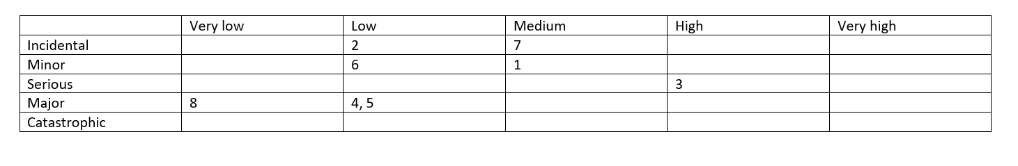
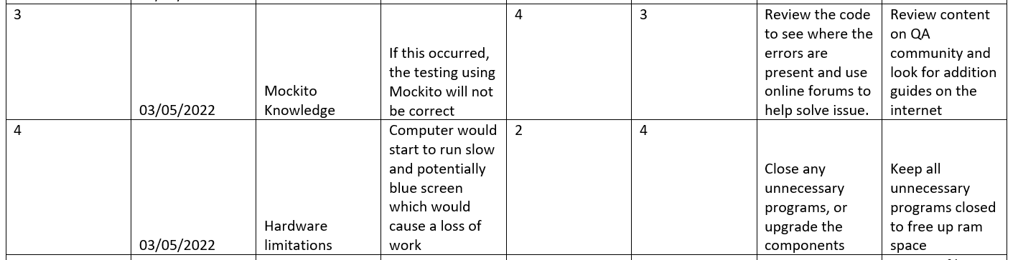
Risk Assessment

Slide 4
Moscow
Must have
- CRUD camera
- CRUD lens
Could have
- Css formatting
- Multiple users
Shouldn’t have
-photo database
-online file storage

Slide 5
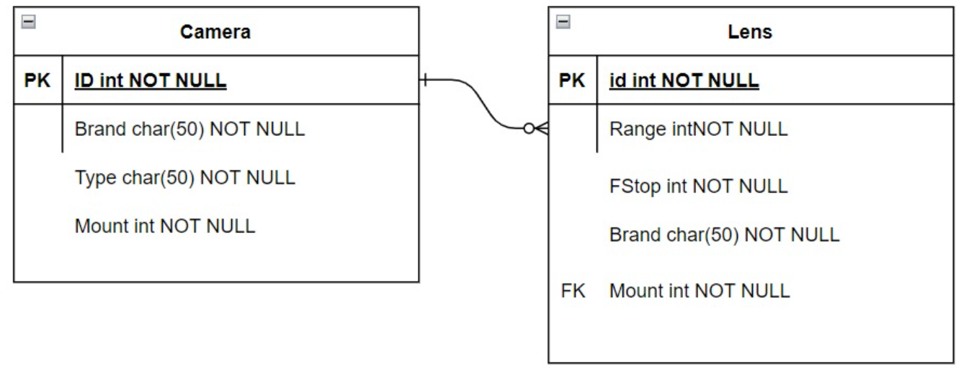
ERD
After

Slide 6
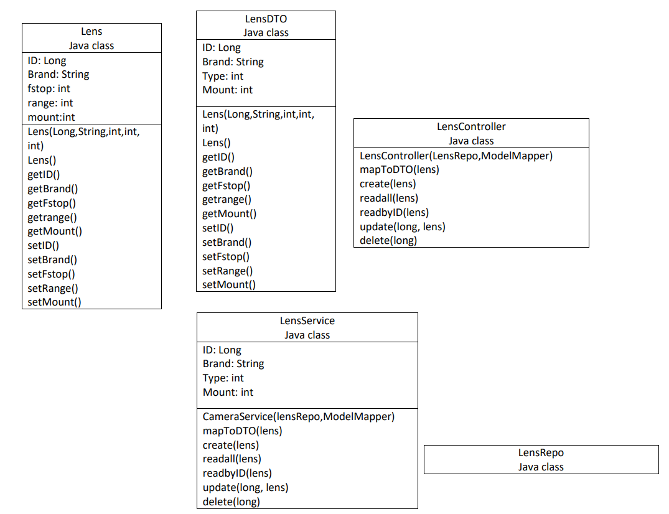
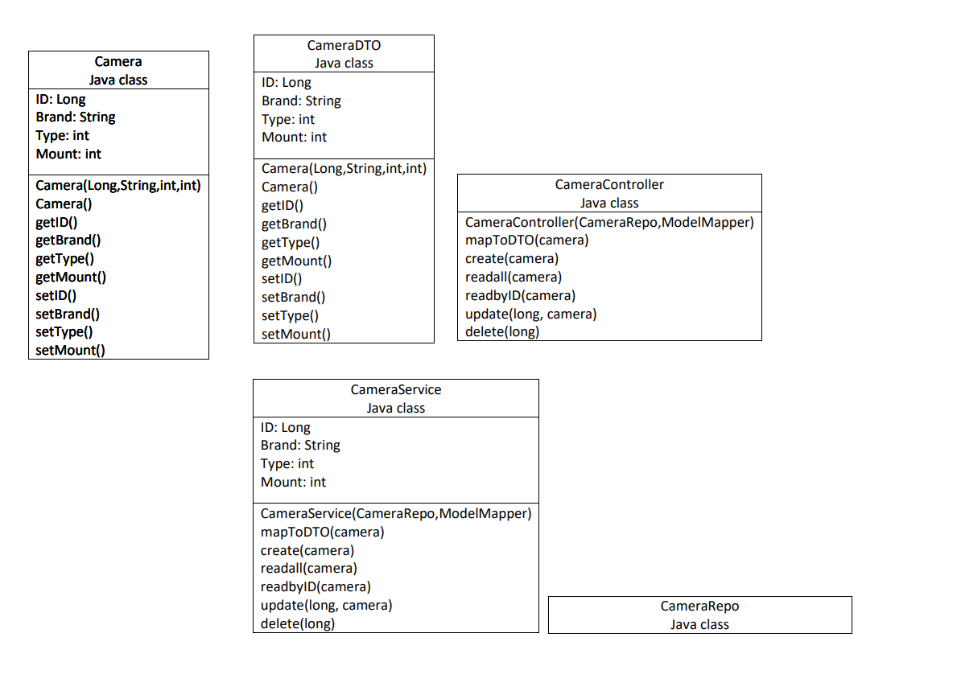
UML Class

Slide 7
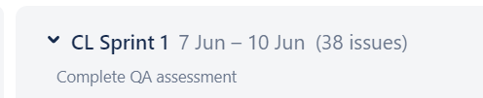
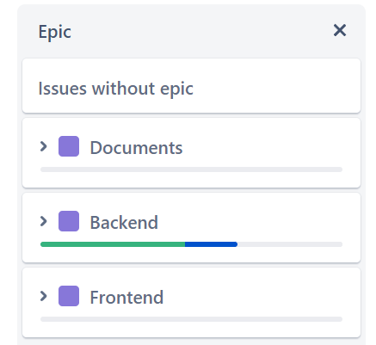
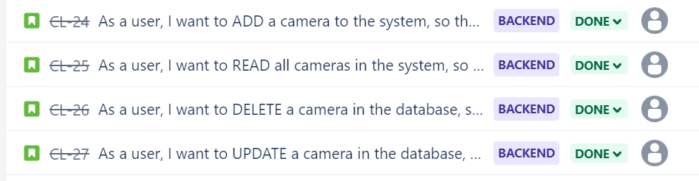
Sprints

Slide 8
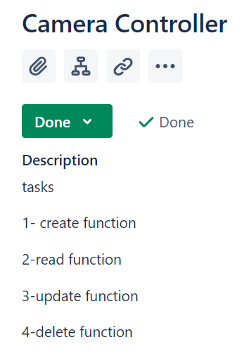
Tasks
Task also had there own user story in Jira
This made Jira integration easier

Slide 9
User Stories

Slide 10
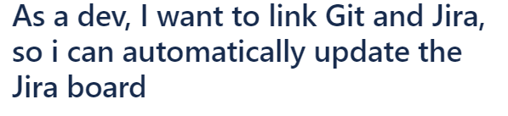
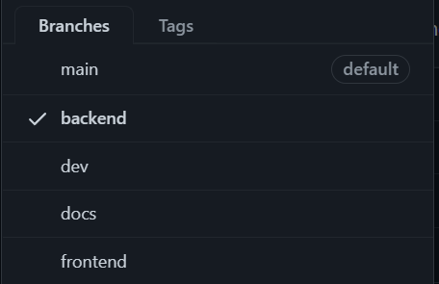
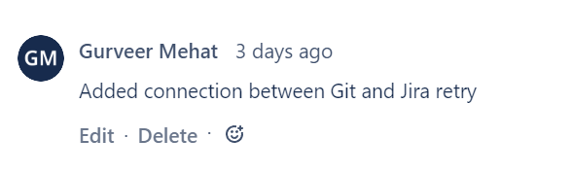
GitHub

Slide 11
Developer Journey
Week 1 new languages
Week 2 knowledge of external apps to help code
Week 2.5 further developed knowledge of Css/js

Slide 12
Version control
0.0.1 – backend
0.0.2 - frontend
Next time
0.1.1 – individual functions
i.E - Sprint completed . Epic . Issue

Slide 13
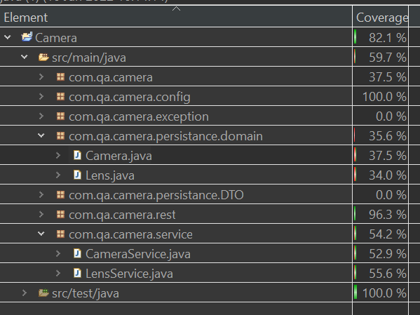
Test Coverage
59.7%
SonarQube error
Didn’t complete smell test

Slide 14
CRUD
CRUD in-progress for Camera and Lens
Update not working
Error 500 on read by id

Slide 15
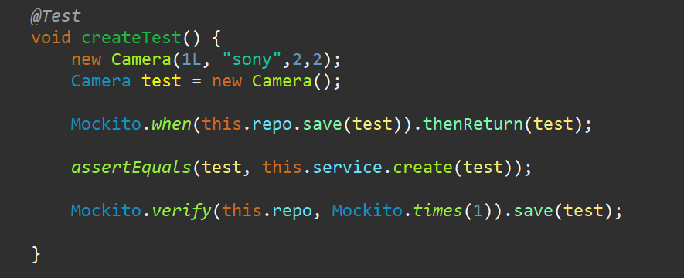
Unit testing
Used Mockito
Isolate the code
Tested try aspect of CRUD code

Slide 16
Demo
Quick test of application

Slide 17
Sprint review
Integrating git bash and Jira
Services and controller Errors
Which increased time spent on crud tasks
Current goal is complete as much as possible
For next time, ask for help don’t push it back
Have a better day-to-day plan

Slide 18
Thank you for listening
Any questions?

